Slide 1
QUALITY SYSTEMS IN PHARMACY

Slide 2
QUALITY SYSTEMS IN PHARMACY
Brief annotation: the discipline is elective in the master's program in 226 Pharmacy, industrial pharmacy. The subject of study of the discipline “Quality Systems in Pharmacy” are quality management systems in pharmacy, approaches to its operation, regulation of pharmaceutical companies.
The purpose of the discipline: is to prepare applicants for higher education in specialty “Pharmacy” for the pharmaceutical sector of health care, who have sufficient theoretical knowledge and practical skills to plan and implement work to control, ensure and manage the quality of processes affecting quality of pharmaceutical products at all stages of its life cycle: from development, research, registration and production to wholesale and retail sales.

Slide 3
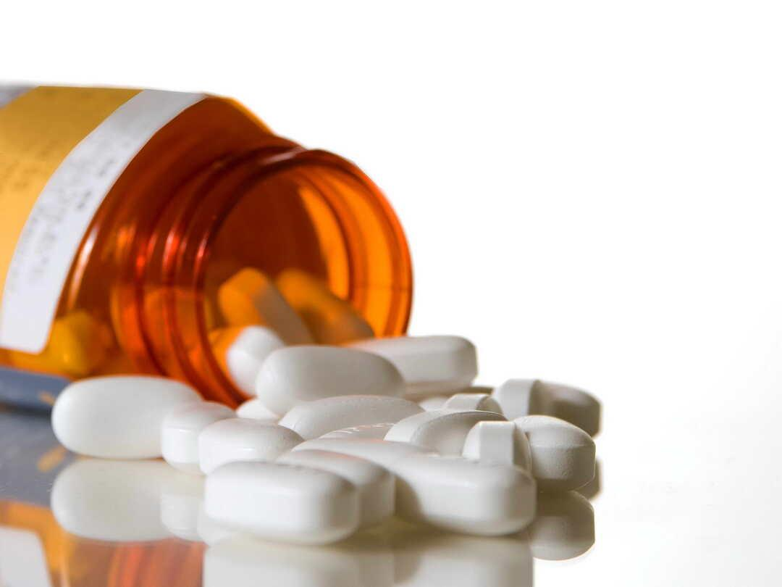
QUALITY SYSTEMS IN PHARMACY
According to the results of training, applicants for higher education will be able to:
- interpret the provisions and requirements of laws and regulations in the field of circulation of medicines;
- to determine the processes necessary for the formation of the quality management system of the pharmaceutical industry;
- compile a list of documents and forms of records (protocols) required for the functioning of the pharmaceutical quality system;
- develop standard documented procedures (including standard operating procedures, SOPs) to regulate the processes of the pharmaceutical quality system;
- to develop standard forms of protocols (records), applicable for registration of data on functioning of processes of pharmaceutical quality system and conformity of production to the established requirements;
-

Slide 4
QUALITY SYSTEMS IN PHARMACY
According to the results of training, applicants for higher education will be able to:
- develop programs and plans for internal audits (self-inspections) of the pharmaceutical quality system, as well as questionnaires, forms (forms) for registration of audit certificates, reports on the results of audits;
- develop corrective action plans to eliminate the consequences and causes of identified inconsistencies in the functioning of the pharmaceutical quality system;
- to formulate indicators and criteria for evaluating the effectiveness of the processes of the pharmaceutical quality system, as well as to choose appropriate methods for such evaluation;
- develop the main provisions of the “Quality Policy” of the organization of the pharmaceutical profile;
- to formulate aims in the field of quality of the organization of the pharmaceutical profile;
- prepare reports on the functioning of the pharmaceutical quality system and action plans for its continuous improvement.

Slide 5
The scheme of the course
Topic 1. Introduction to the course "Quality Systems in Pharmacy". Chronology of world development of science on quality assurance and management. The concept of good pharmaceutical practices (GXP) and their role in quality assurance at all stages of the life cycle of medicines. Regulatory framework for ensuring and quality control of medicines in the European Union.
Topic 2. Activities of regulatory organizations in the field of medicines circulation: their functions and sphere of work. Analysis of the main elements of the state quality assurance system of medicines. The role of the International Pharmacopoeia. Certification and licensing of pharmaceutical market players
Topic 3. The concept of quality management system of enterprises - subjects of the pharmaceutical market (pharmaceutical quality systems). Review of the requirements of ISO 9001 standard, universal and industry guidance ICH Q10 Pharmaceutical Quality System. Stages of construction of PQS.
Topic 4. The concept of integrated management systems of enterprises – subjects of the pharmaceutical market. Overview of the requirements of ISO 14001, ISO standards 22000 HACCP, ISO 13485

Slide 6
The scheme of the course
Topic 5. Regulation and documentation processes PQS. Development of quality manual, documented implementation PQS processes and standard operating procedure
Topic 6. Analysis and risk assessment for quality in pharmaceutical development, production and distribution of medicines. Methods for the determination analysis and risk assessment for drug quality
Topic 7. The activities of the validation of manufacturing processes and qualification of equipment and auxiliary systems in enterprises, the subject of the pharmaceutical market
Topic 8. Internal audits (self-inspections) of pharmaceutical quality systems: organization, documentary support, audit techniques, psychological and ethical aspects. Corrective and preventive actions (CAPA).

Slide 7
TEACHERS
OLENA TKACHENKO
Candidate of Pharmaceutical Sciences, associate professor, associate professor of department of management, economy and quality assurance of the National University of Pharmacy. Academic experience – 34 years, scientific-pedagogical experience – 12 years. She gives lectures, conducts practical classes in the disciplines “Системи якості у фармації”, “Quality systems in pharmacy”, “Good pharmaceutical practices”. Research interests: creation of organizational and methodological bases for training quality management specialists for the pharmaceutical sphere of healthcare; development and scientific substantiation of methodological approaches to the formation, implementation and continuous improvement of pharmaceutical quality systems in accordance with the requirements of ISO 9000 series standards and GxP guidelines for pharmaceutical companies and cosmetic companies, etc.
OLENA LITVINOVA
Doctor of Pharmacy, PhD in Biology, senior research assistant, professor, professor of department of management, economy and quality assurance in pharmacy of the National University of Pharmacy. Academic experience – more than 20 years, scientific-pedagogical experience – 15 years. She gives lectures: “Strategic management of the organization” (masters); “Intellectual business” (masters); “Methodology and logic of scientific research” (masters); “Good pharmaceutical practices” (masters). Research interests: intellectual resources, innovation, patent protection, pharmacology.

